Slide 1

IOT BASED BANK LOCKER SECURITY SYSTEM

Slide 2
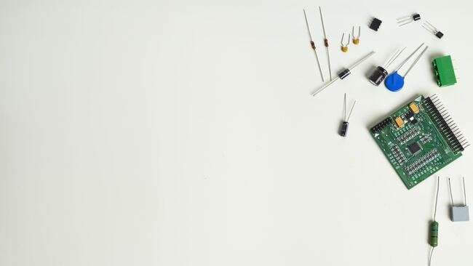
PCB DESIGINING
SUBMITTED BY: GURPREET SINGH(C0761753)
GROUP: #2

Slide 3
UNTIL NOW
Before starting the task, initially we will review what all we have done till now with respect to the project that we had proposed.
Till now, we are done with the interfacing of buzzer, Servo motor, Vibration sensor, Arduino mega, Fingerprint sensor, GSM SIM900 Module, ESP8266 Module, ESP32 Module, Touchscreen and RTC Module with beaglebone black.
In order to make interfacing possible we used various functions and features of C programming and various communication protocols are used such as UART, SPI, I2C and GPIO that required various libraries as to gain the control over GPIO pins we installed “iobb library.”
Finally, after the successful interfacing of all the components; the next task is to desgin the PCB online.

Slide 4
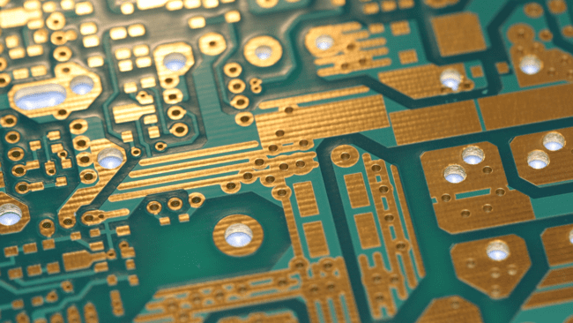
TASK OBJECTIVE
To generate an appropriate PCB design for an IOT based bank locker security system.

Slide 5

INTRODUCTION
In today’s task we try to accomplish the making of our project look like a product i.e., making sure we have minimum wires appearing on the project using Zero PCB.
This task is related to the Task #4 of getting the schematic ready for this project. So, the schematic will be needed in this task to convert that into the PCB design.
In order to complete this task, the same software is used that is used previously to generate the Schematic i.e., EasyEDA(Electronic Design Automation).
Therefore, we need not to install the software, it can be used online on any web browser such as Google Chrome, Firefox, etc.

Slide 6

WHAT IS PCB DESIGINING??
PCB designing is a computer-aided designing technology.
It is used to plan and design circuit boards for electronics circuits design to deliver a specific output.
It can be done for both through-hole and surface mount electronic components.
Typically, any electronic PCB design involves putting together a combination of power supply systems, control systems, communication systems, input, output systems together in a single or multiple PCBs that can work in interfacing with each other.

Slide 7

WHY PCB DESIGNING IS IMPORTANT??
The Printed Circuit Board (PCB) is very important in all electronic gadgets, which are used either for domestic use, or for industrial purpose. PCB design services are used to design the electronic circuits. Apart from electrically connecting, it also gives mechanical support to the electrical components. The PCB designs can be created both manually and automatically.
An effective PCB design can help in reducing the possibilities of errors and the chances of short circuit. A creative PCB designer has great chances to explore the field.

Slide 8
WHY PCB DESIGNING IS IMPORTANT??
The PCB editor edits the layers in the PCB, both single and multilayered. Both two dimensional and three-dimensional view of the image are possible. 3D view is preferred, since it is possible to analyze both the inner and outer designs clearly.

Slide 9
REQUIREMENT
For the completion of this task we require the EASYEDA software and Gerbv — a Gerber (RS-274X) viewer.

Slide 10
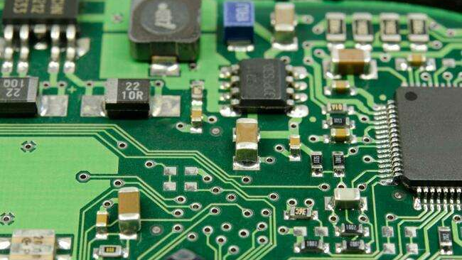
INTRODUCTION TO EASYEDA SOFTWARE
It is an easier and powerful web-based Electronics Design Automation (EDA) tool that help the user to access it anywhere at anytime, so software installation is not mandatory. Like user can install it on their personal computers as it is compatible with LINUX, WINDOWS and MAC OS. For our project, we are using EASYEDA online.
This Photo by Unknown Author is licensed under CC BY-SA-NC

Slide 11
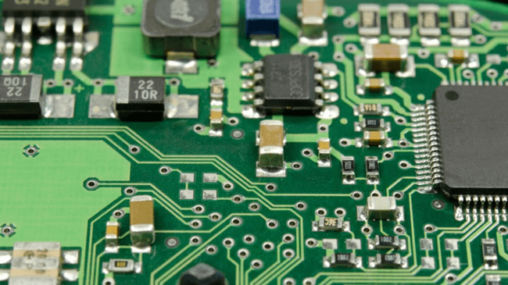
INTRODUCTION TO EASYEDA SOFTWARE
EASYEDA is a very user friendly and simple to use software. All the components are easily available in the Library, user can select the desired components, drag and place it.
EASYEDA official sites comes with the tutorials that help the new user to understand the software easily.

Slide 12
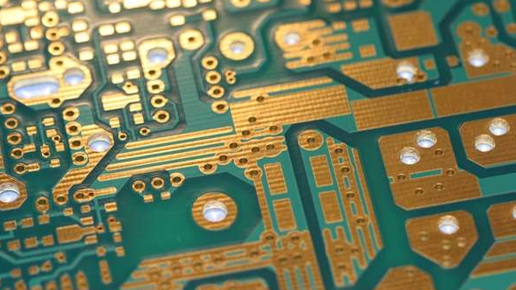
FEATURES OF EASYEDA
Simple, Easier, Friendly, and Powerful general drawing capabilities
Schematic Capture
PCB Layout
Working Anywhere, Anytime, Any Device
Real-time Team Cooperation
Direct Links to LCSC Components for Selection
Integrated PCB Fabrication
Import Altium/Kicad/Eagle,PNG,DXF
More Than 1 Million Free Libraries
Script Support

Slide 13

GETTING STARTED WITH EASY EDA
If the user is using the software online, so the initial steps user must take is register to the site so that their work can be saved easily.
Once the user is register, for the next time user need to login, and user can see all their work.

Slide 14

GETTING STARTED WITH EASY EDA
Once the user login through the registered account the main window will pop up on the screen.
Now the user can make anything they want to like schematic design, or PCB design.

Slide 15
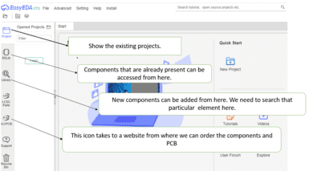
BASICS OF EASY EDA

Slide 16
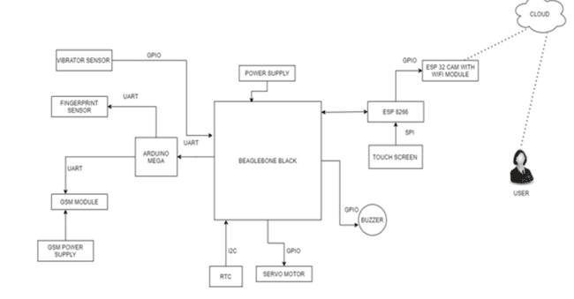
BLOCK DIAGRAM OF PROJECT

Slide 17
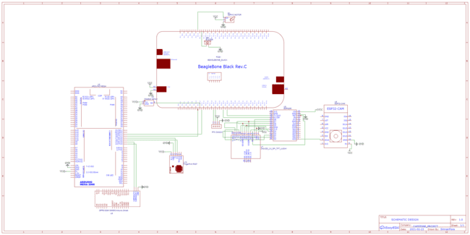
SCHEMATIC DIAGRAM

Slide 18
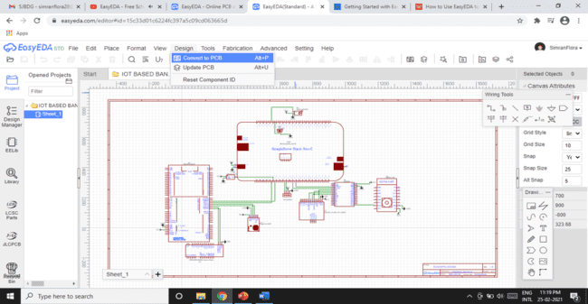
PCB DESIGNING PROCESS
Step 1: Finalize your Circuit Design – It starts with the circuit design and without a circuit there is no need for a PCB.The circuit design is capture directly into a schematic.

Slide 19

PCB DESIGINING PROCESS
Step 2: Choose PCB Design Software –Its important to choose a package that is first and foremost easy to use, but also capable of completing the pcb design as some packages won’t be able to handle the complexity.
This Photo by Unknown Author is licensed under CC BY-SA

Slide 20
PCB DESIGINING PROCESS
Step3: Capture Your Schematic – As mentioned earlier its likely that the circuit design is being captured electronically from the start. In general, “capturing the schematic” is the process by which each component is drawn electronically and are interconnected with each other.

Slide 21
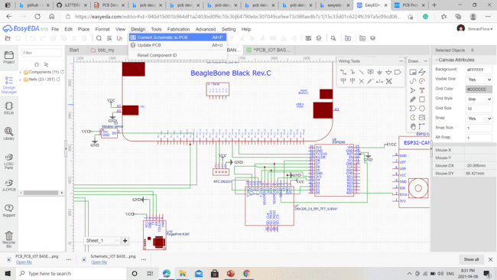
PCB DESIGINING PROCESS
Step 4: Converting the Schematic into the PCB– Once the schematic is complete its time to convert it into the PCB design.

Slide 22
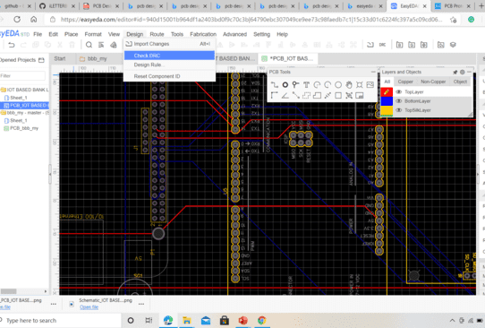
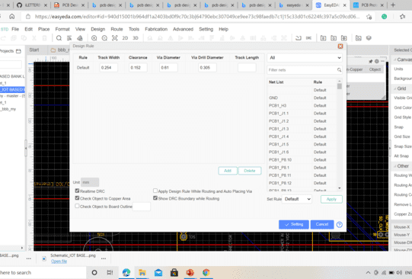
PCB DESIGINING PROCESS
Step 5: Setup Design Rules – With the PCB outline and PCB footprints complete is just about time to start the placement. Before placement thought you should setup the design rules to ensure that components or traces aren’t to close together. This is only one example as there are probably hundreds of different rules that can be applied to a PCB design.

Slide 23
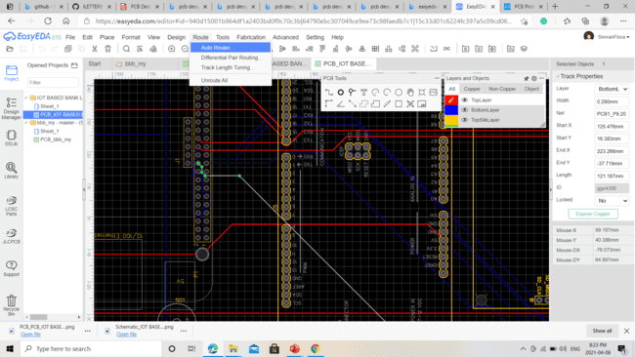
PCB DESIGINING PROCESS
Step 6: Auto Route Traces – In order to get the correct clearance between each trace, auto routing can be done after connecting the comments.
It provide effective routing of traces by minimizing vias.

Slide 24
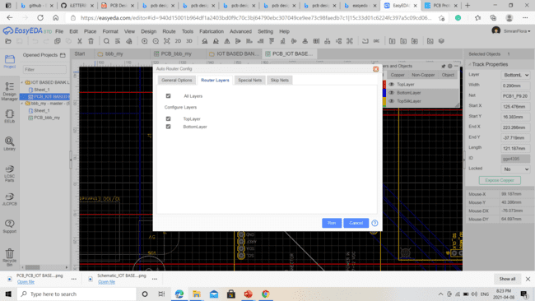
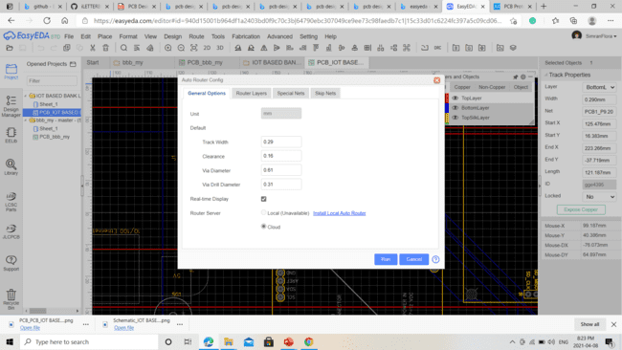
PCB DESIGINING PROCESS

Slide 25
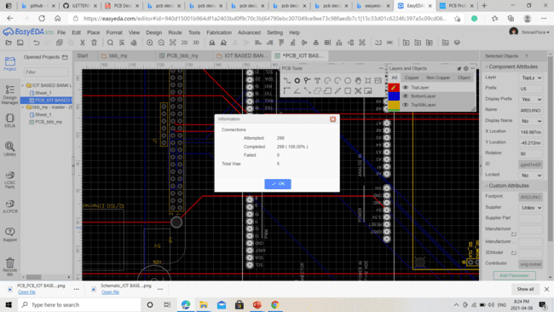
PCB DESIGNING PROCESS

Slide 26
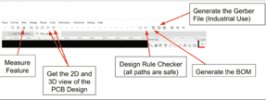
PCB DESIGNING PROCESS
Once, we had made the proper routing, we can then generate the desired files which will be used for the manufacturing of PCB.
Through this we could generate the BOM(Bill of Materials) and check if the tracks are proper using the DRC(Design Rule Check).

Slide 27
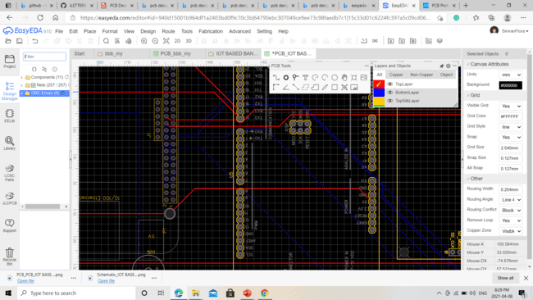
PCB DESIGNING PROCESS
STEP7: CHECKING THE DRC – DRC (Design Rule Check) errors are checked as if the tracks are proper.

Slide 28
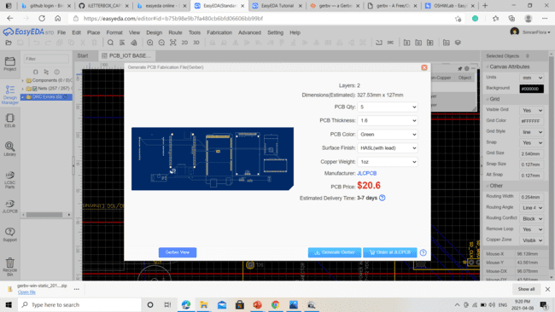
PCB DESIGINING PROCESS
Step 11: Output Gerber Files – Once the board is error free it’s time to output the gerber files. These files are universal and are needed by the pcb fabrication houses to manufacture your printed circuit board.

Slide 29
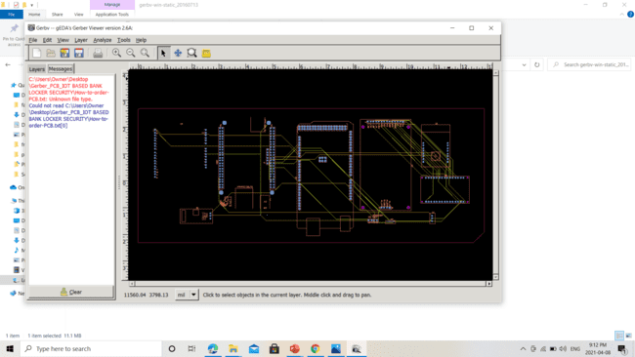
GERBER FILE VIEW: LAYERS

Slide 30
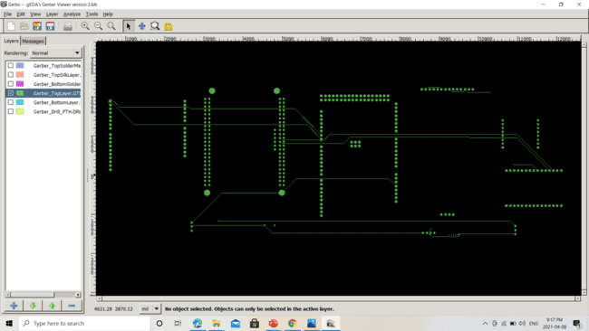
GERBER FILE: TOP VIEW

Slide 31
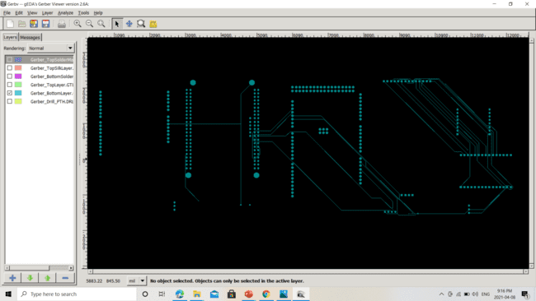
GERBER FILE: BOTTOM LAYER

Slide 32
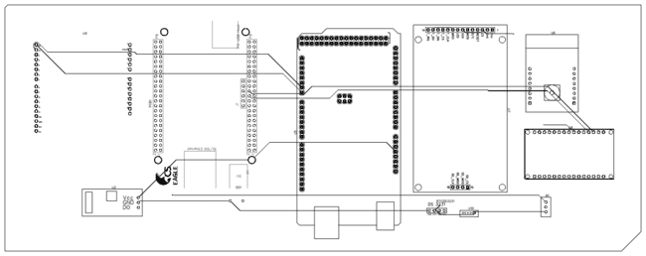
PCB DESIGN OF THE PROJECT

Slide 33
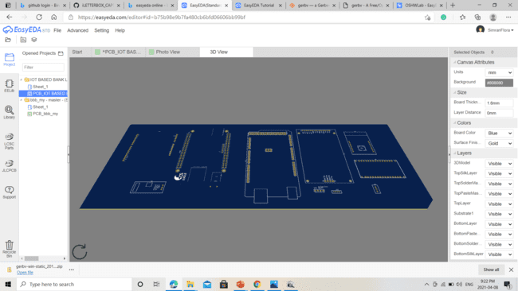
3D VIEW

Slide 34
REFERENCES
PCB design: https://www.lydnow.com/pcb-designing#:~:text=What%20is%20PCB%20designing%3F%20PCB%20designing%20is%20a,for%20both%20through-hole%20and%20surface%20mount%20electronic%20components
Importance of PCB design: Importance of PCBs | Enventure
PCB Designing Layout: PCB Design Process & Workflow | PCB Design - Design Your Printed Circuit Board the Right Way.
Designing PCB: https://www.youtube.com/watch?v=1e4lOJeqAc8
Extracting the Geber Files: gerbv — a Gerber (RS-274X) viewer download | SourceForge.net

Slide 35
THANK YOU

